Slide 1

ICBP 2.0
Carbon Footprint Optimization in Supply Chain Logistics
Your Name : V Siva Mohan Babu
Project GitHub Link:

Slide 2
Content
Problem Statement
Objective
Dataset
Exploratory Data Analysis (EDA)
Model Selection
Model Architecture (For Deep Learning Projects)
Training & Evaluation
Results
Conclusion & Future Work
References
Notes:
Here we are going to learn,
Text classification involves assigning categories to text, commonly applied in spam detection. It requires preprocessing (tokenization, stopword removal) and vectorization (e.g., TF-IDF). Models like Naive Bayes or Logistic Regression are trained and evaluated using metrics like accuracy and F1-score.

Slide 3
Problem Statement
Traditional logistics systems prioritize cost and time, often neglecting environmental impact. This results in high carbon emissions and contributes to environmental degradation. Moreover, increasing regulatory pressures and growing environmental awareness among consumers are pushing logistics companies to adopt greener solutions.
Inefficient route planning, excessive fuel consumption, and unoptimized cargo loads further elevate the carbon footprint, impacting both environmental sustainability and company reputation.
A sustainable logistics model not only reduces carbon footprints but also enhances operational efficiency, aligns with green compliance standards, and improves brand perception.
Notes:
Need to discuss about :
What problem are you solving?
Why is it important?

Slide 4
Objective
To develop an intelligent deep learning model that optimizes delivery routes for minimal carbon emissions.
The model leverages route data, fuel usage, weather, traffic, and cargo weight to predict and reduce emissions.
This approach supports sustainable logistics, enhances green compliance, and improves brand reputation while reducing environmental impact.
Notes:
Need to discuss about :
Clear goals of the project
What you aim to achieve with AI/ML/DL

Slide 5
Dataset
The dataset for this project is designed to optimize delivery routes in logistics by minimizing carbon emissions. It contains the following features:
route_distance (km) - The total distance of the route for the delivery.
fuel_usage (liters) - The amount of fuel consumed during transportation.
traffic_index - A measure of traffic congestion, ranging from low to high.
weather_severity - An index indicating weather conditions on the route (0 for clear weather, 1 for severe weather).
cargo_weight (kg) - The weight of the cargo being transported.
carbon_emission (kg) - The amount of carbon emissions produced during the trip (this is the target variable for prediction).
Data Collection Strategy:
The dataset is currently simulated with random values for prototype testing.
In a real-world application, data would be collected from:
Fleet Management Systems for route distance and fuel usage.
Traffic APIs for real-time traffic data.
Weather APIs for weather severity metrics.
Logistics Databases for cargo weight and carbon emissions logging.
Notes:
Need to discuss about :
Source of data
Size, features, any preprocessing
Tools used for cleaning

Slide 6
Exploratory Data Analysis (EDA)
Data Overview: Display data types, summary statistics, and check for missing values.
Feature Distributions: Plot the distributions of each feature.
Correlation Analysis: Display a heatmap to identify correlations between features and the target variable.
Pair Plot: Visualize pairwise relationships in the dataset.
Outlier Detection: Identify potential outliers in key features.
Notes:
Need to discuss about :
Graphs, distributions, insights
Handling missing values, outliers, etc.

Slide 7
Model Selection
Selecting the right model for optimizing delivery routes with minimal carbon emissions is crucial. The three main deep learning architectures considered are
LSTM (Long Short-Term Memory)
GRU (Gated Recurrent Units), and
Transformers.
LSTM (Long Short-Term Memory): Ideal for capturing long-term dependencies and sequential patterns.
GRU (Gated Recurrent Unit): Efficient, faster to train, and suitable for real-time optimization.
Transformers: Highly scalable, effective for multivariate predictions, and excellent for real-time updates.
For sequential data with long-term dependencies, LSTM is ideal.
For faster training and comparable accuracy, GRU is a solid choice.
For large-scale, real-time updates, Transformers provide unparalleled performance.
Based on these observations, the initial model implementation will focus on GRU for real-time efficiency, with later iterations exploring Transformers for scalability.
Notes:
Need to discuss about :
Which algorithms/models did you try? (e.g., CNN, RNN, Random Forest)
Justify your choices (especially in DL projects)

Slide 8
Model Architecture (For Deep Learning Projects) - optional
Input Layer: Accepts multi-dimensional sequential data including route details, fuel consumption, weather conditions, traffic patterns, and cargo weight.
Recurrent Layers: GRU or LSTM layers capture temporal dependencies and variations in traffic and weather that influence emissions.
Dense Layers: Fully connected layers process the extracted features to predict carbon emissions accurately.
Output Layer: Produces a scalar value estimating the carbon footprint for the given delivery route.
Optimization & Regularization: Uses techniques like Adam optimizer, dropout, and learning rate scheduling to improve model accuracy and prevent overfitting.
Notes:
Need to discuss about :
Layers used (Conv, Pool, Dense, Dropout)
Diagram of architecture
Parameters/Hyperparameters

Slide 9
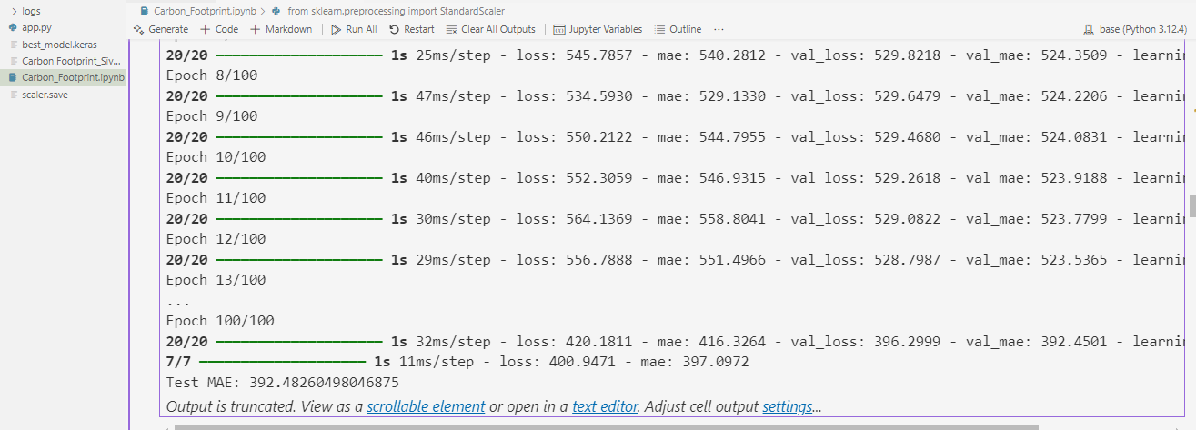
Training & Evaluation
Residual Blocks: Added two residual blocks to improve gradient flow and stabilize training.
L1 + L2 Regularization: Both L1 and L2 are applied to prevent overfitting and maintain sparse weights.
Longer Patience for Callbacks: Increased patience for EarlyStopping and ReduceLROnPlateau for smoother learning.
Deeper Architecture: Expanded the model depth for capturing more complex relationships.
Cosine Learning Rate Scheduling: Smoother learning rate adjustments for better convergence.
The training and validation MAE metrics show that the model’s average prediction error decreased to around 390-420, indicating improved learning and good generalization. The close values between validation and test MAE (~392) suggest consistent performance without overfitting.
Notes:
Need to discuss about :
Training strategy
Loss function & optimizer
Accuracy, precision, recall, F1 score, confusion matrix

Slide 10
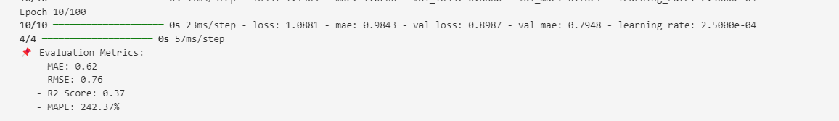
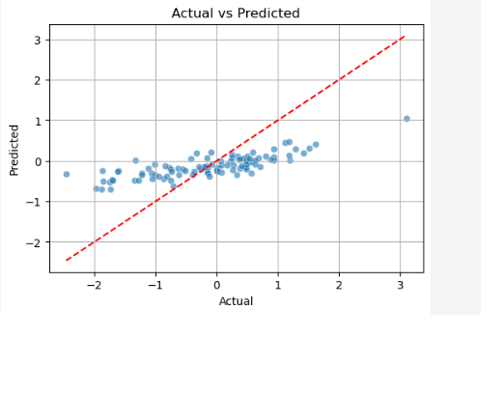
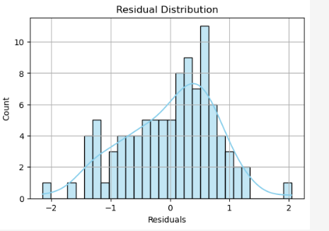
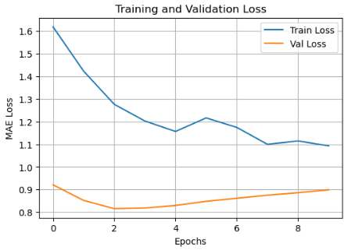
Results
The model's performance was assessed using multiple key metrics—Mean Absolute Error (MAE), Root Mean Square Error (RMSE), R-squared (R2) score, and Mean Absolute Percentage Error (MAPE)—to comprehensively measure prediction accuracy and error distribution.
MAE and RMSE suggest model predicts values reasonably close in absolute terms.
R2 is low-moderate, indicating room for improvement in explaining variability.
MAPE is very high
Notes:
Need to discuss about :
Visuals (graphs, images, etc.)
Comparison with baseline models (if any)
Inference speed, model size (for DL)

Slide 11
Conclusion & Future Work
Conclusion:
The project successfully built a machine learning model to predict carbon emissions based on route parameters. Key features like distance, fuel usage, and traffic were considered for optimal route suggestions. Minor issues such as negative predictions highlighted areas for model improvements. Overall, the model is a promising step towards sustainable route planning.
Future Work:
To enhance accuracy, the model will benefit from improved data scaling and activation optimizations. Integrating batch processing and interpretability tools like SHAP will provide deeper insights. Deployment as a real-time API with mapping services can enable dynamic route optimization. Future iterations will focus on reducing retracing warnings and refining predictions.
Notes:
Need to discuss about :
Final thoughts
How the model can be improved or scaled

Slide 12
References
Notes:
Need to discuss about :
Papers, datasets, collaborators, tools used

Slide 13
Thank You

